Slide 1
Past Perfect Simple Sentences

Slide 2
Complete the sentences using the verb in brackets in the correct tense.
I became interested in Science after I _________________________ (visit) the Science Museum in London.
When I got home, I discovered I _______________________ (lost) my keys.
She _______________ (miss) the plane because her alarm ___________________ (not go) off.

Slide 3
Complete the sentences using the verb in brackets in the correct tense.
I _______________ (meet) her before, but I couldn’t remember where.
We ______________ (arrive) 20 minutes late, but everyone _________________ (leave) already.
He was very hungry because he _____________________ (not eat) since breakfast.

Slide 4
Complete the following sentences using the past perfect simple.
1. She was fired from her job because…
2. The house was a complete mess because…
3. She got home more than three hours late because…
4. He looked exhausted because…
5. He was only wearing one sock because…

Slide 5
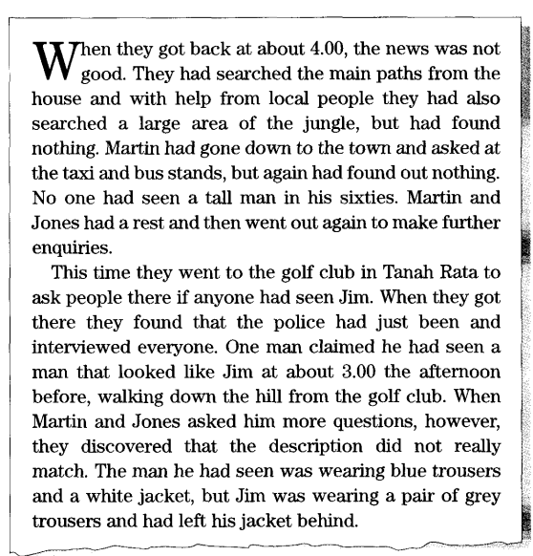
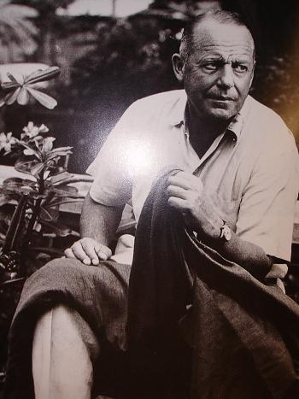

Slide 6
Read the story about the mysterious disappearance of Jim Thompson in Malaysia in 1969. Underline any examples of the past perfect.
Draw a table like the one below. In the columns, write:
4 events that happened BEFORE 4:00
4 events that happened AFTER 4:00
1 event for which we don't not know the time
BEFORE 4:00 | AFTER 4:00 | DON’T KNOW

